Slide 1
MARKET EQUILIBRIUM
NAPINDER KAUR
Assistant Professor

Slide 2
LEARNING OUTCOMES
After the lecture, you will be able to
Understand the working of market equilibrium.
Analyse the adjustments in market equilibrium.

Slide 3
MARKET EQUILIBRIUM
Market equilibrium implies that there is neither excess demand nor excess supply.

Slide 4
MARKET EQUILIBRIUM
Price | Supply (‘000 cups of coffee a month) | Demand (‘000 cups of coffee a month)
15 | 10 | 50
20 | 15 | 40
25 | 30 | 30
30 | 45 | 15
35 | 70 | 10

Slide 5
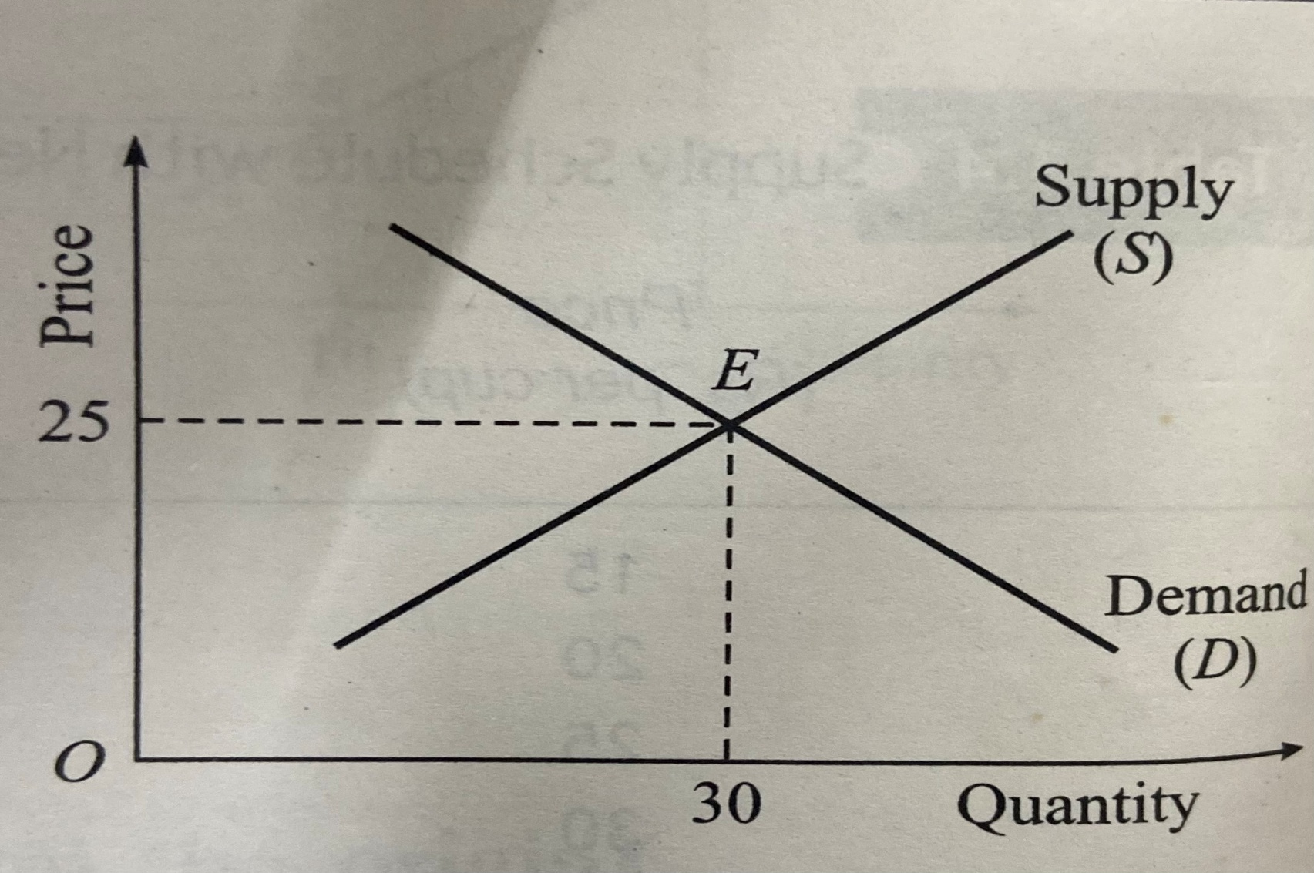
MARKET EQUILIBIRUM

Slide 6


Slide 7
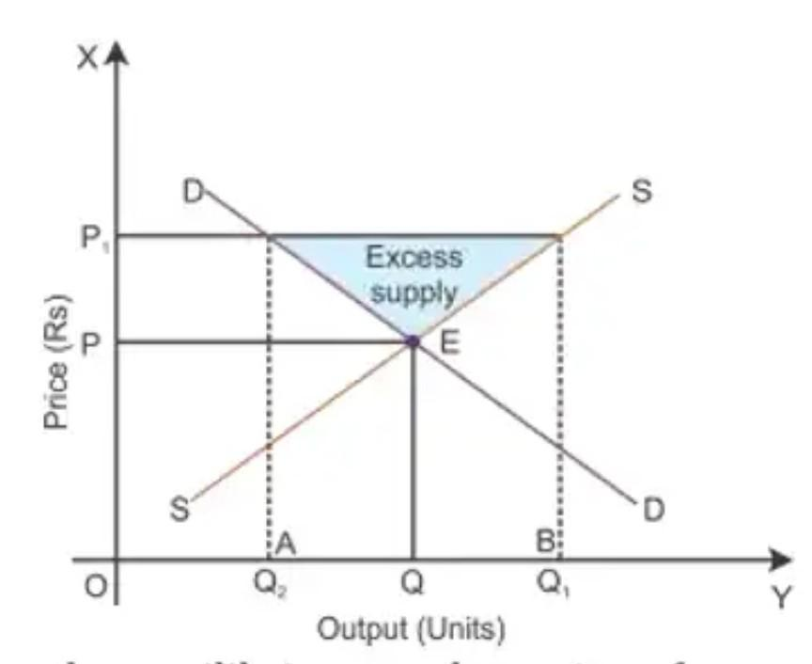
EXCESS SUPPLY
Excess supply can be mathematically expressed as:
ES = Qs - Qd

Slide 8

EXCESS SUPPLY CASE

Slide 9
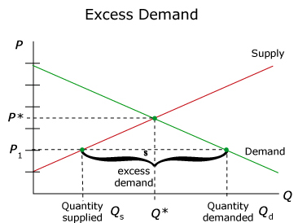
EXCESS DEMAND
ED = Qd – Qs

Slide 10
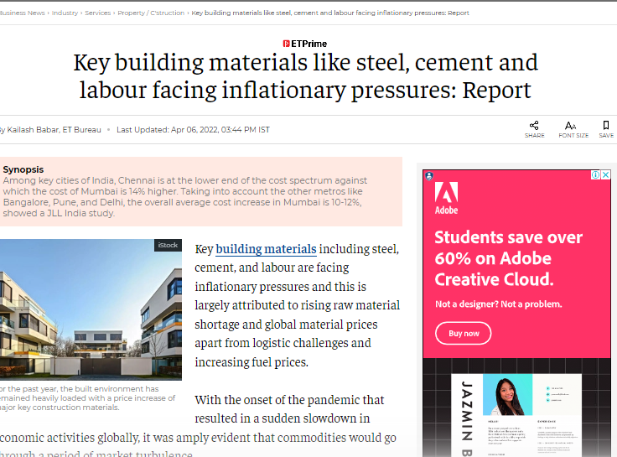
EXCESS DEMAND CASE

Slide 11
PRICE ADJUSTMENT MECHANISM
If Qs > Qd, market price decreases, the quantity demanded will increase and quantity supplied will decrease until it becomes equal to quantity demanded.
If Qd > Qs, price increases, the quantity demanded will decrease and quantity supplied will increase until it becomes equal to quantity demanded.

Slide 12
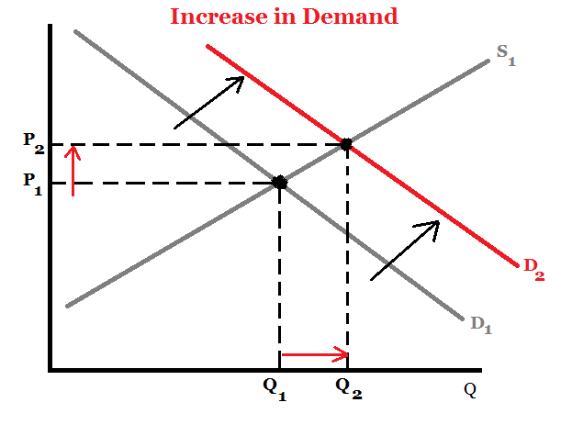
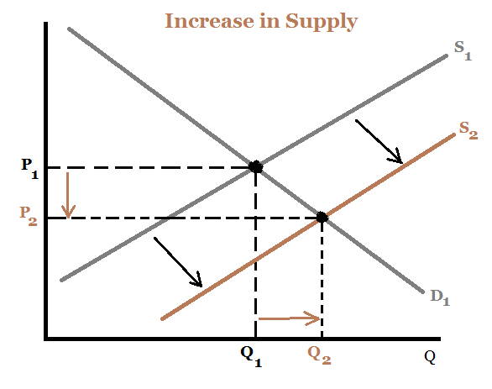
CHANGES IN MARKET EQUILIBRIUM
Change in demand
Change in supply

Slide 13
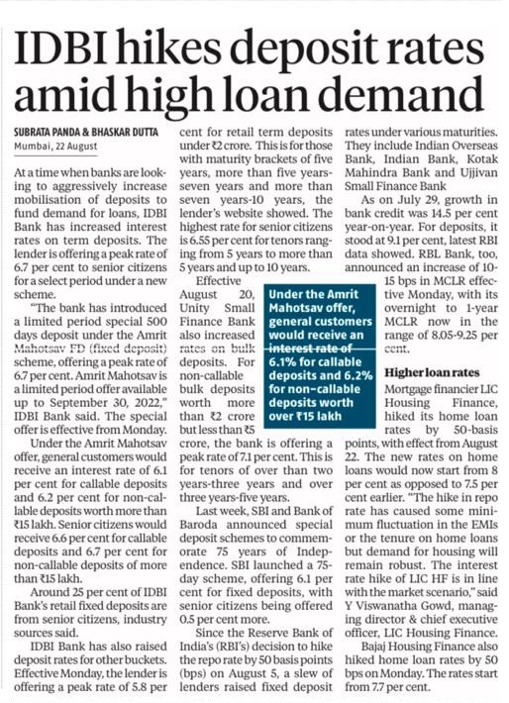

Slide 14


Slide 15
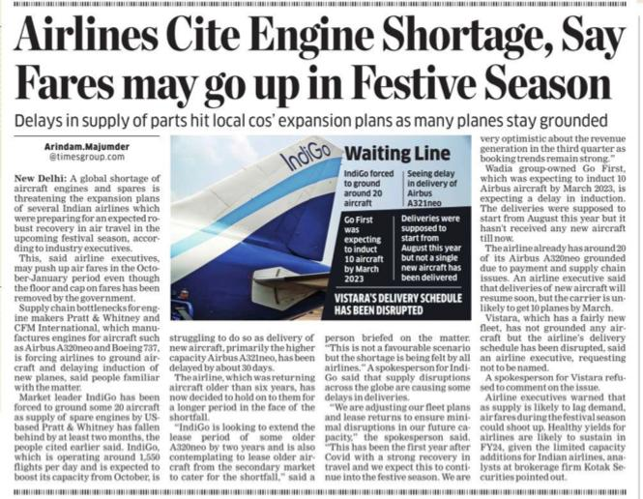

Slide 16
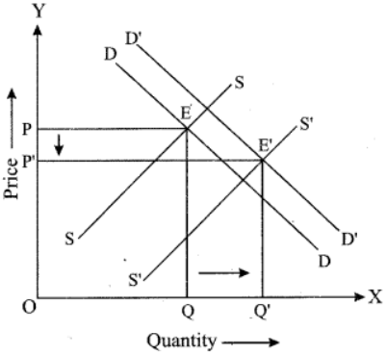
CHANGE IN BOTH DEMAND AND SUPPLY

Slide 17
SOLVE
Given the following demand and supply functions, find the equilibrium price and quantity in the market:
Demand: Qd = 100 – P
Supply: P = 10 + 2Qs

